Slide 1
NORTHEASTERN UNIVERSITY DATA MINING APPLICATIONS
Behavioral Analysis on a Shopping site using Google Analytics Data
By
Dishant Modi

Slide 2
INTRODUCTION
The dataset is obtained from google analytics to determine the performance of the website.
The activates on the website, determine the possibility of purchase of the product by a customer.
We are finding the revenue generated, by the page visits, region, operating system and the Browser type.
“Time and money are your scarcest resources. You want to make sure you’re allocating them in highest-impact areas. Data reveals impact, and with data, you can bring more science to your decisions.”
Matt Trifiro, CMO at Heroku

Slide 3
ATTRIBUTES
Administrative -Number of different pages visited related to the administrative concerns of the website
Informational -Number of different pages visited related to the information of the website and other useful contents of the website
ProductRelated-Number of different pages visited related to different products of the website.
BounceRate - Percentage of users who left the website from the landing page
ExitRate - Percentage of users who left from the page they visited
Page Values -Page Value is the average value for a page that a user visited before making a transaction.
Browse - bowsers from which the session took place
Region - ID of Regions from which the session took place
Traffic Type - different types of sources from which the users landed on the website
User Type - Whether the user is a returning user or a new user or of any other type
Revenue -Whether the user contributed to the revenue by purchasing or not
Weekend - Whether the session was on a weekend or not

Slide 4
TOOLS
Python 3.7 with Jupyter Notebook
Scikit-Learn – For machine learning models
Pandas – Data cleaning and operations on data
MatPlotLib and Seaborn – For plotting graphs

Slide 5
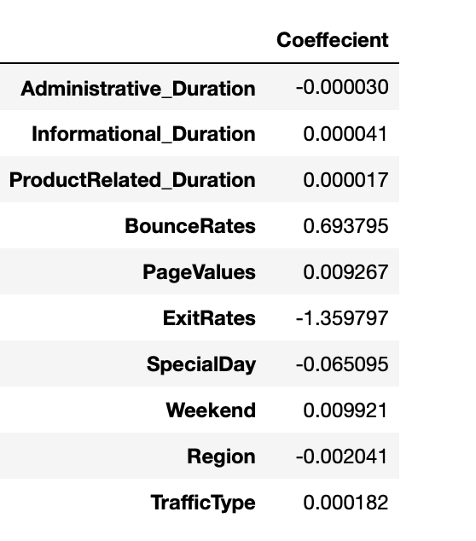
COEFFICIENT OF DETERMINATION

Slide 6
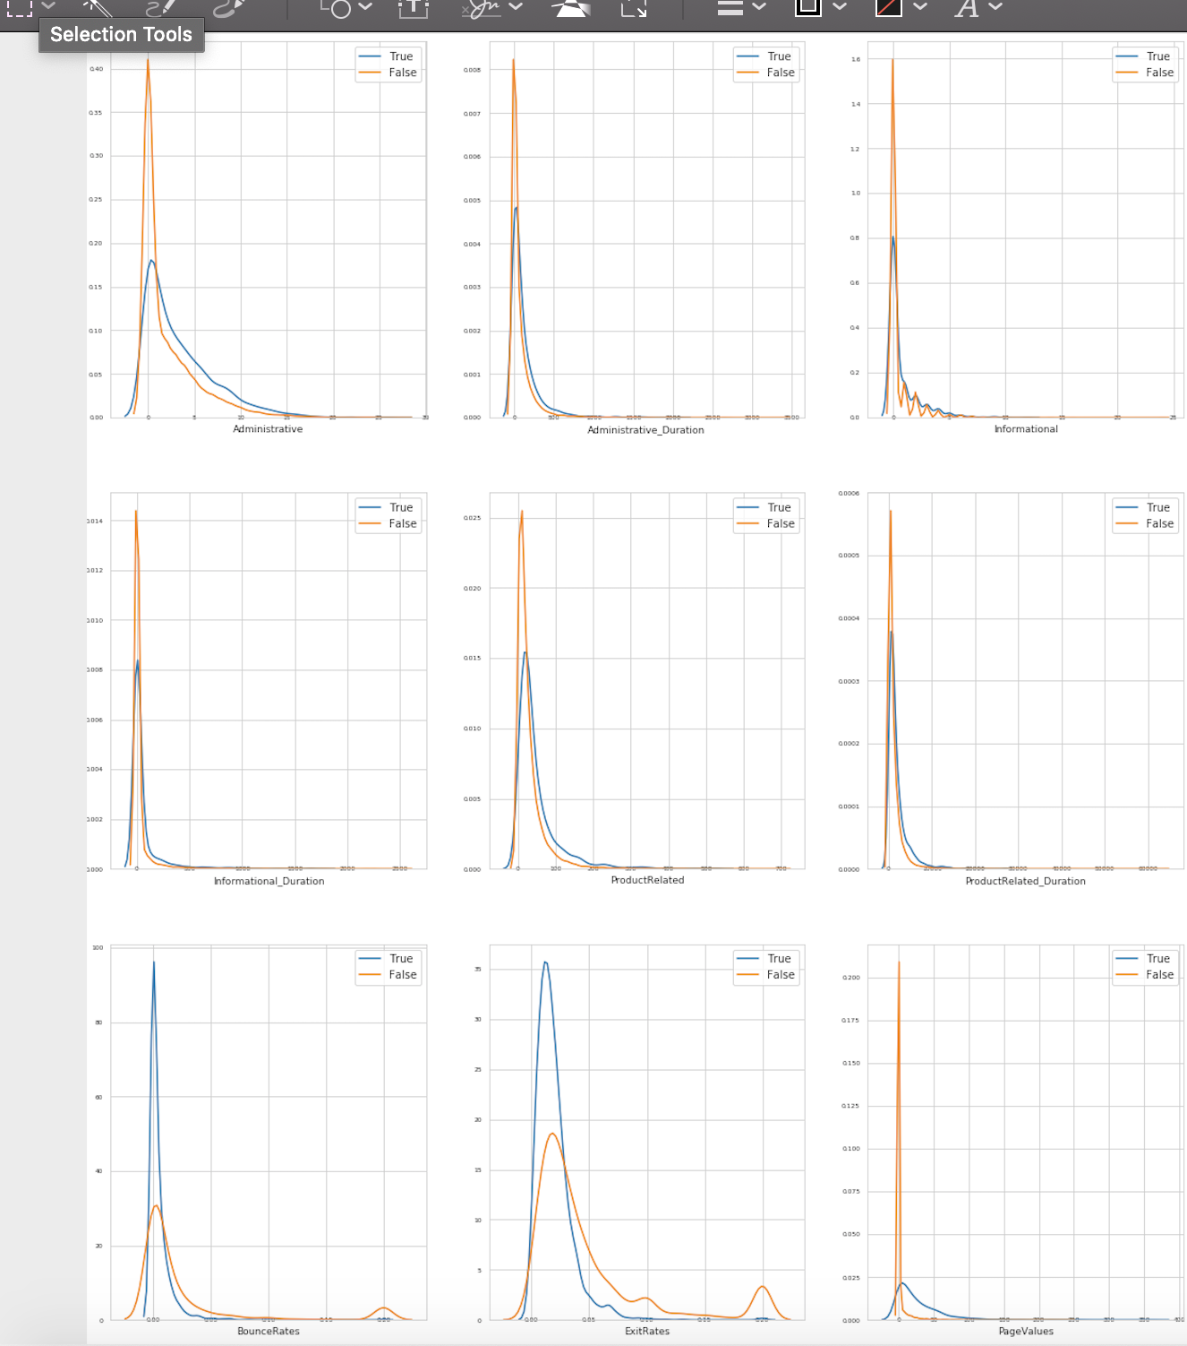
REVENUE GENERATION BY PAGE

Slide 7
REVENUE ON SPECIAL DAYS AND WEEKENDS

Slide 8
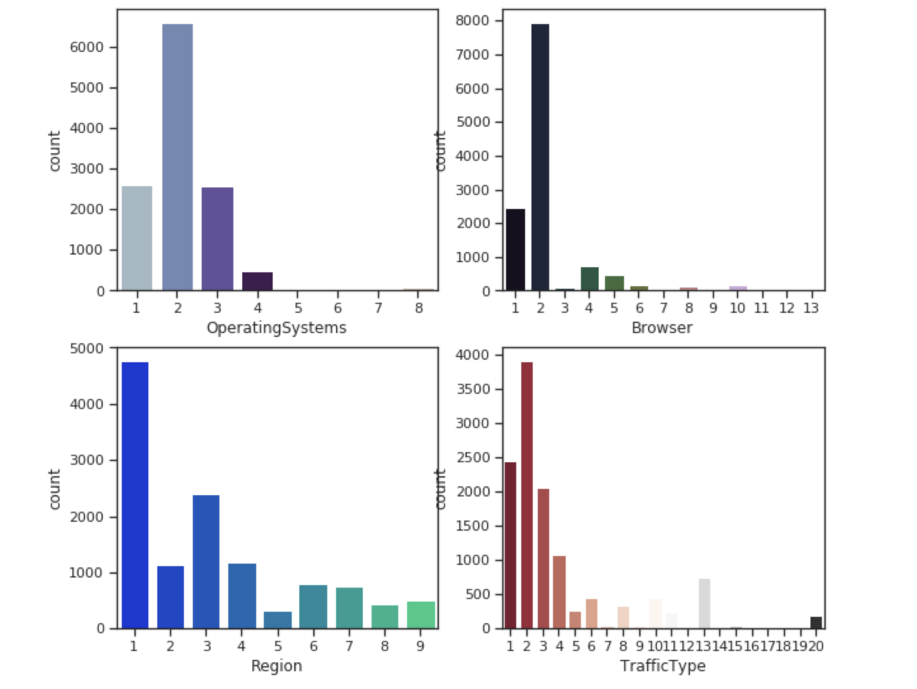
DISTRIBUTION OVER REGION AND BROWSER

Slide 9
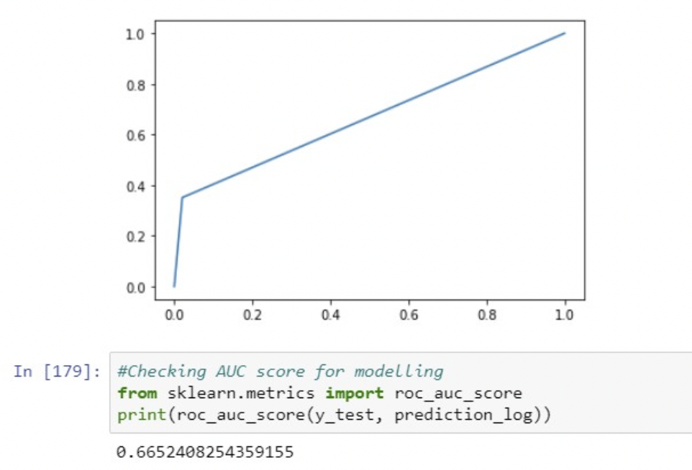
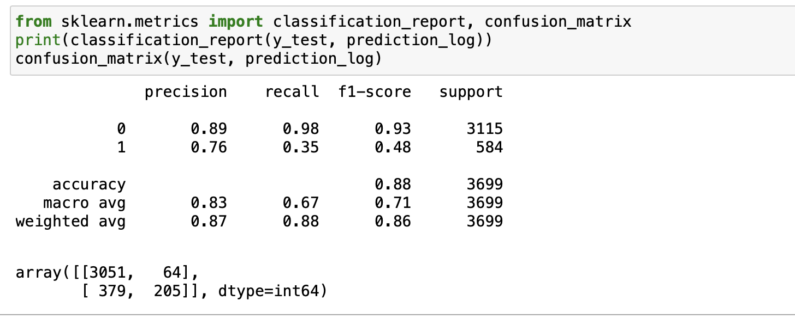
REGRESSION
Accuracy: 88% (0.88 F1 score)
Accuracy: 66%

Slide 10
REVENUE GENERATION BY WEBPAGES

Slide 11
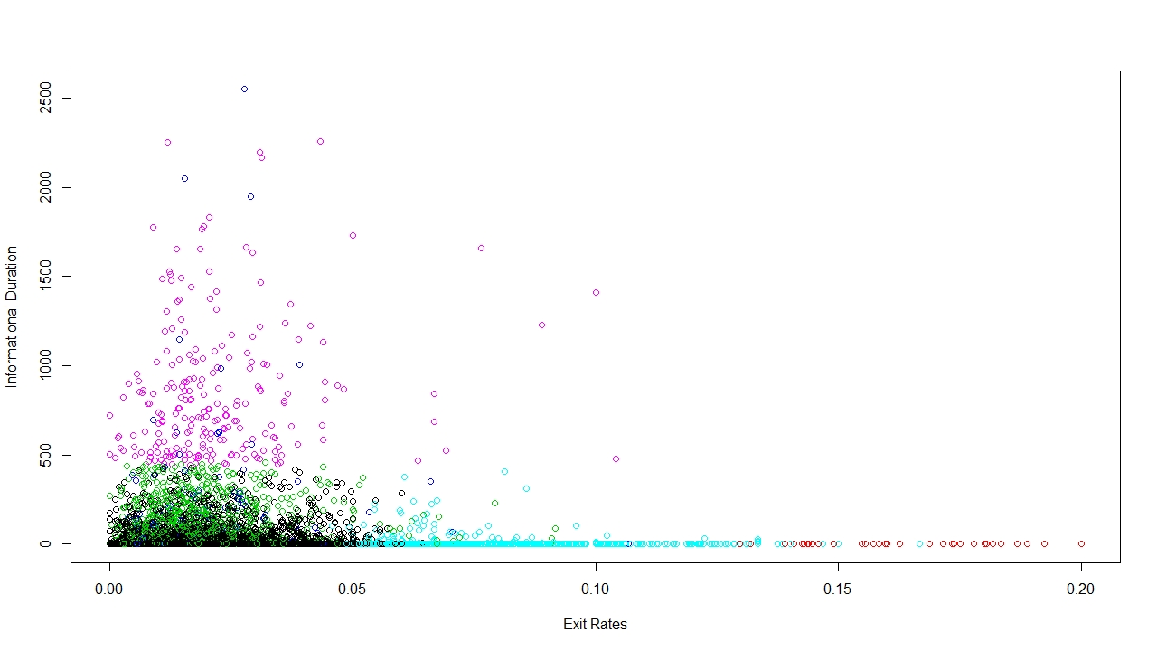
K-MEANS CLUSTERING

Slide 12
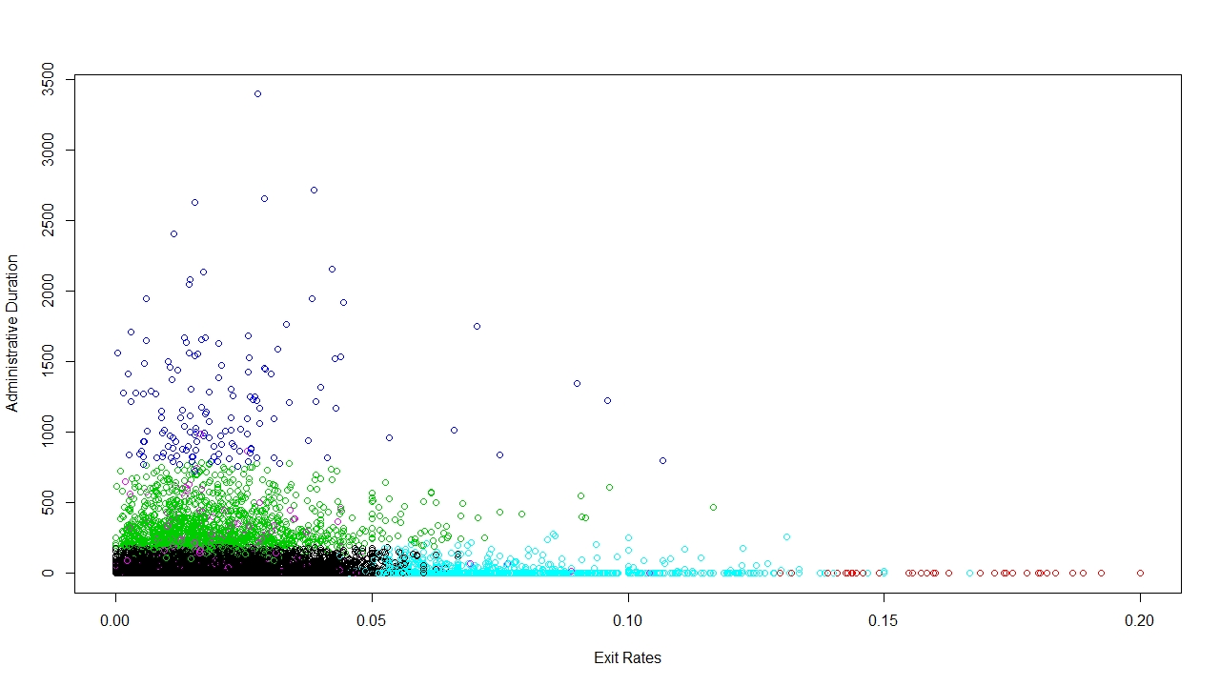
K-MEANS CLUSTERING

Slide 13
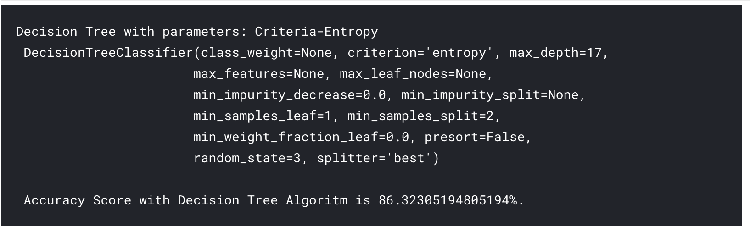
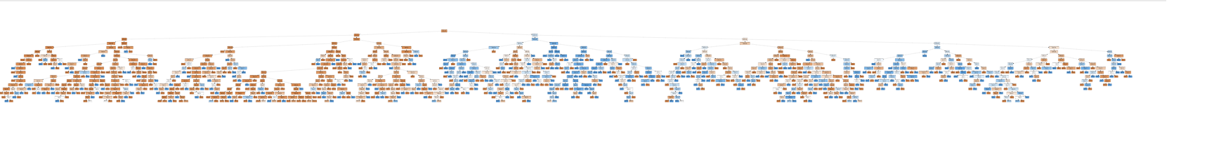
DECISION TREE

Slide 14
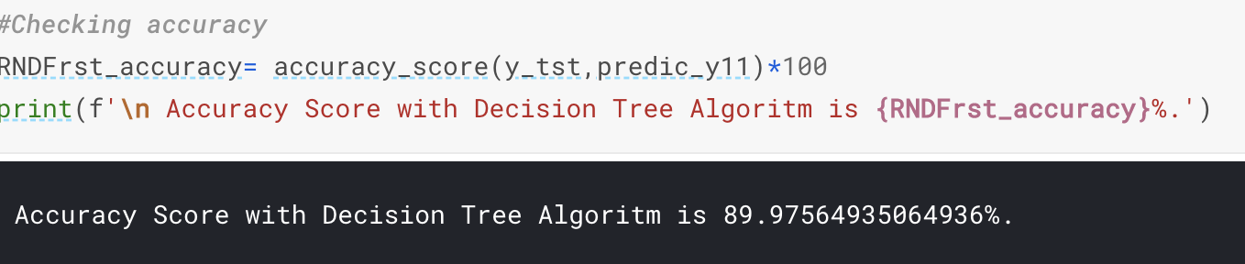
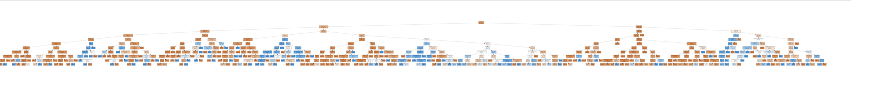
RANDOM FOREST

Slide 15
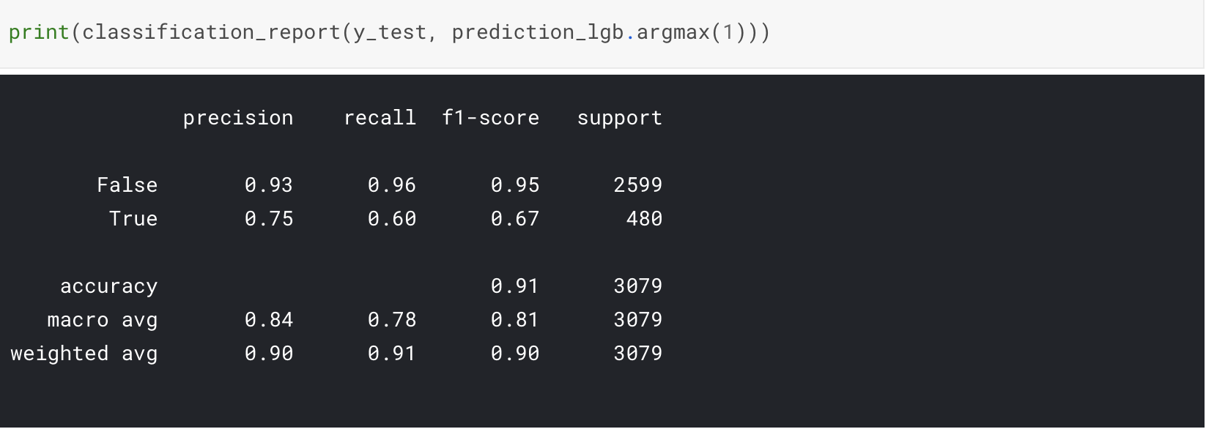
REGULARISATION USING GBM MODEL
GBM Accuracy: 91%

Slide 16
CONCLUSION
The duration spent by the customer on each page determines customer retention
There are several factors upon which revenue depends however values like exit rate, region, administrative duration, operating system etc.
Also traffic type and OS has a correlation meaning majority of traffic comes from a most widely used system.
Comparing accuracy of every model we can see that GBM (Gradient Boosting Machine) gives the best accuracy

Slide 17
Thank You

